Slide 1
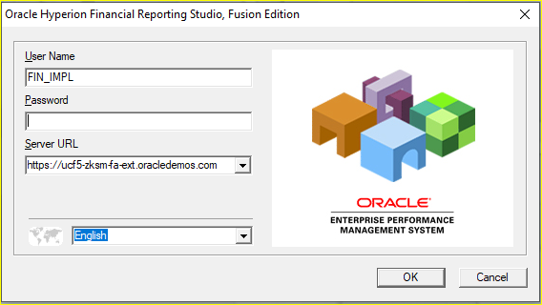
Oracle Financial Reporting Studio
Financial Reporting Studio is a tool from Oracle Hyperion which provides facility to create different financial reports.
This tool is user friendly to create report with drag and drop facility.

Slide 2
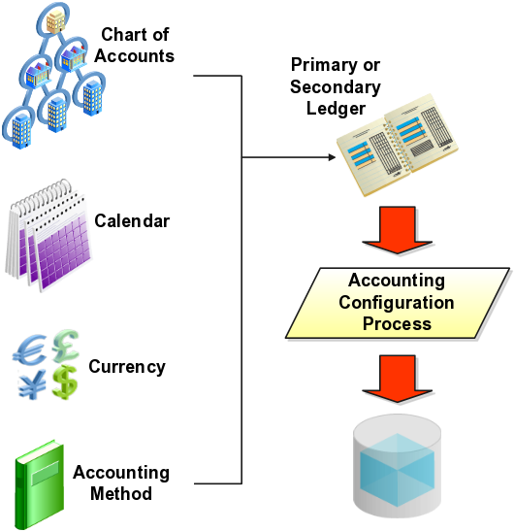
Hierarchical financial data in FRS report comes from multi dimensional Essbase database.

Slide 3
Key features of FRS
Architecture of this report provides flexibility, scalability to the business.
We don’t have to write any query to fetch the data from database.
If there is any changes in general ledger related data, report will be refreshed with set of data.
You can drill down from parent value to child value to get the detail level balances.
Increase business productivity by providing report in different format like pdf, excel, word, xml.
You can add different mathematical function without writing any difficult formula.

Slide 4
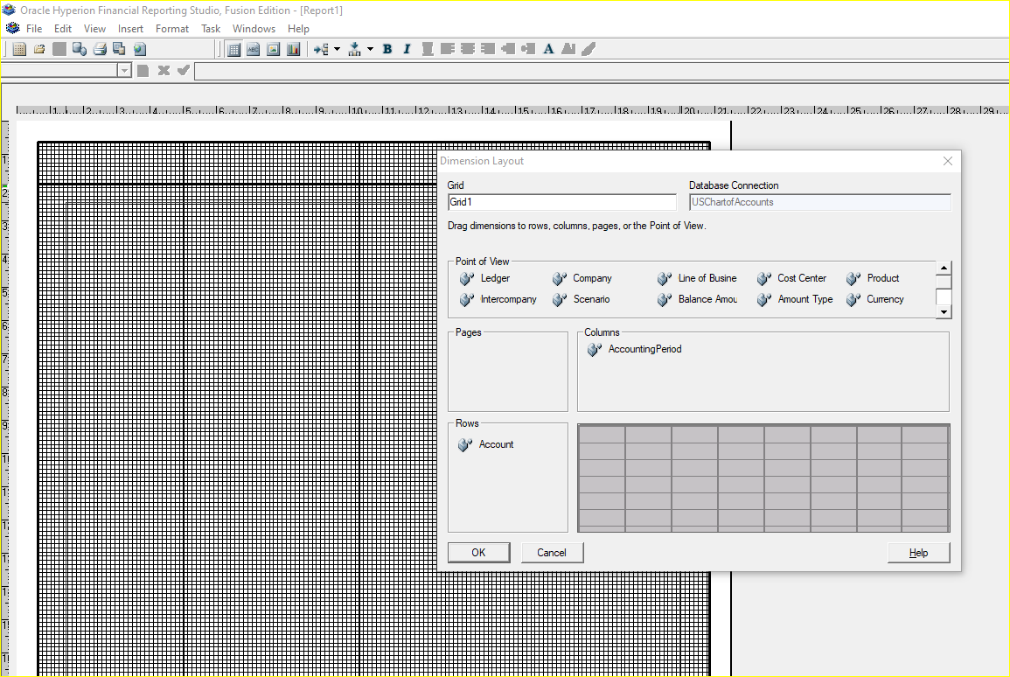
Different components of FRS
Grid
Dimension
Point of View
Report Heading
Text Box
Graph
Pre built function

Slide 5
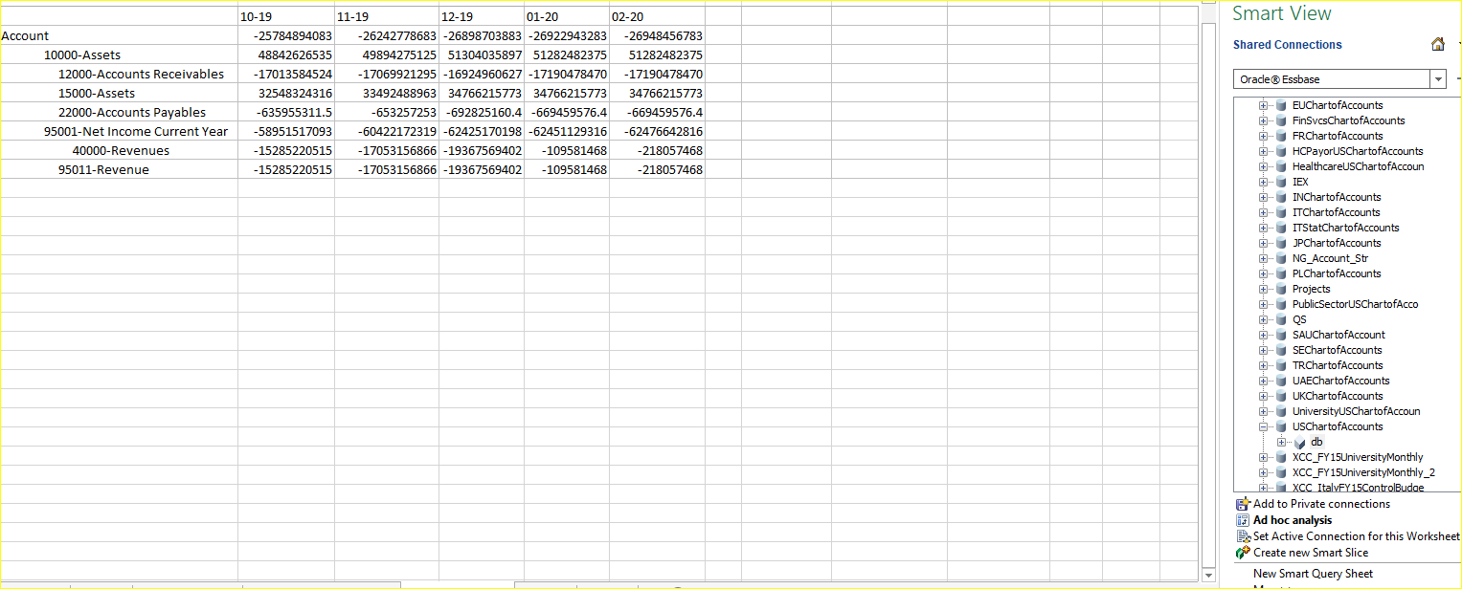
Oracle Hyperion Smart View
Smart view is specially designed for Oracle Enterprise Performance Management, but you can make use of this tool in fusion financials module also. This is basically an excel based utility rather you can say it is a Microsoft excel add-in.

Slide 6
Key Features of Smart View
Fusion smart view provides drag and drop facility to create different financial statement
It has the ability to drill down to the detail level balances
User can create pivot analysis to get the data in different dimension and share the data through email or offline.

